Slide 1
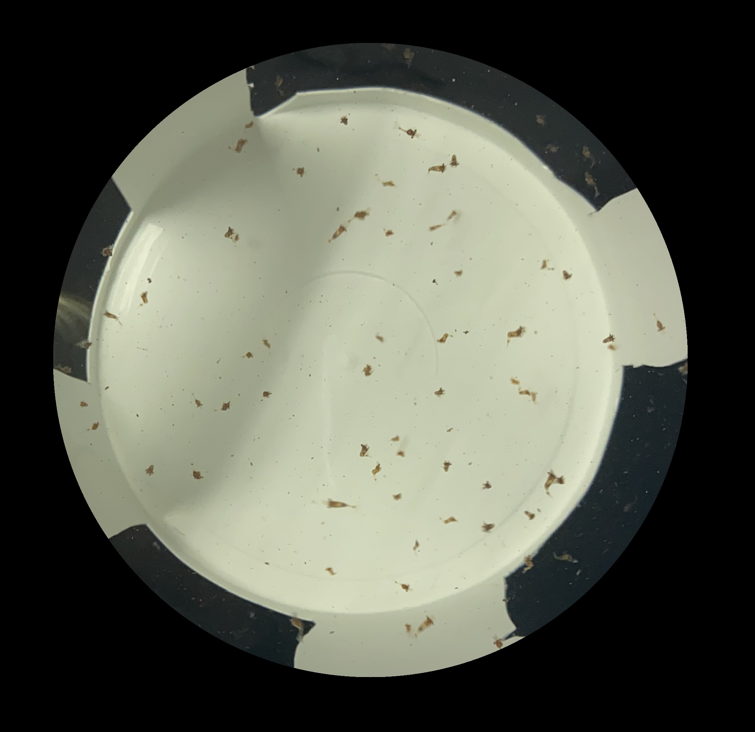
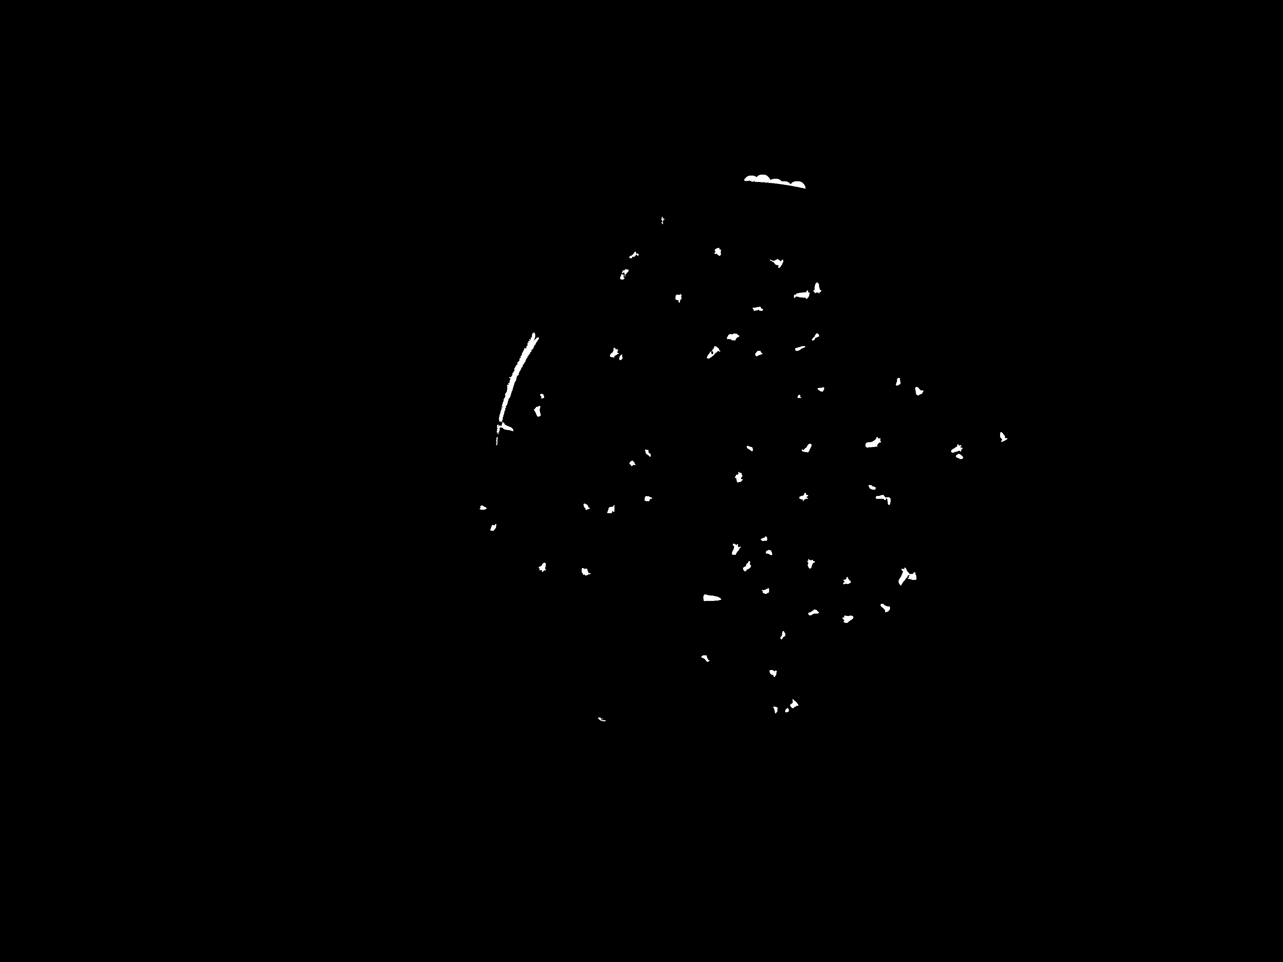
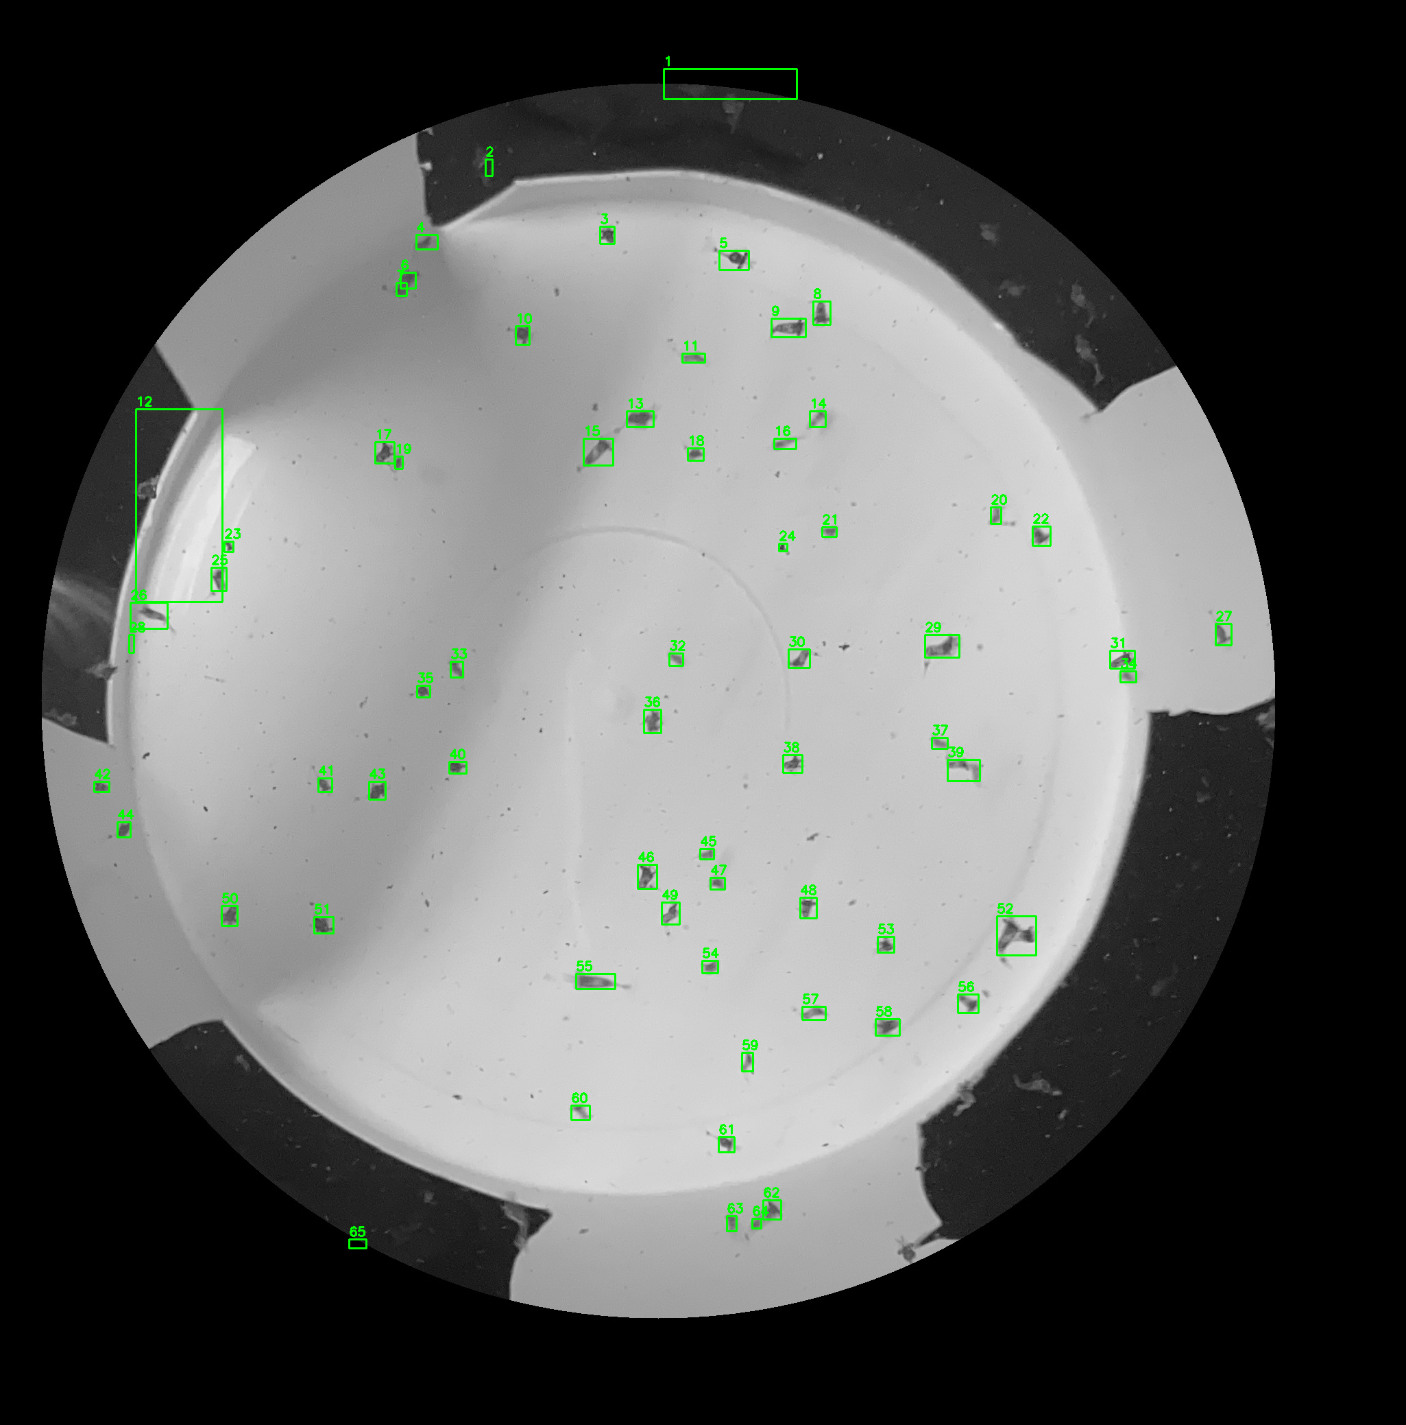


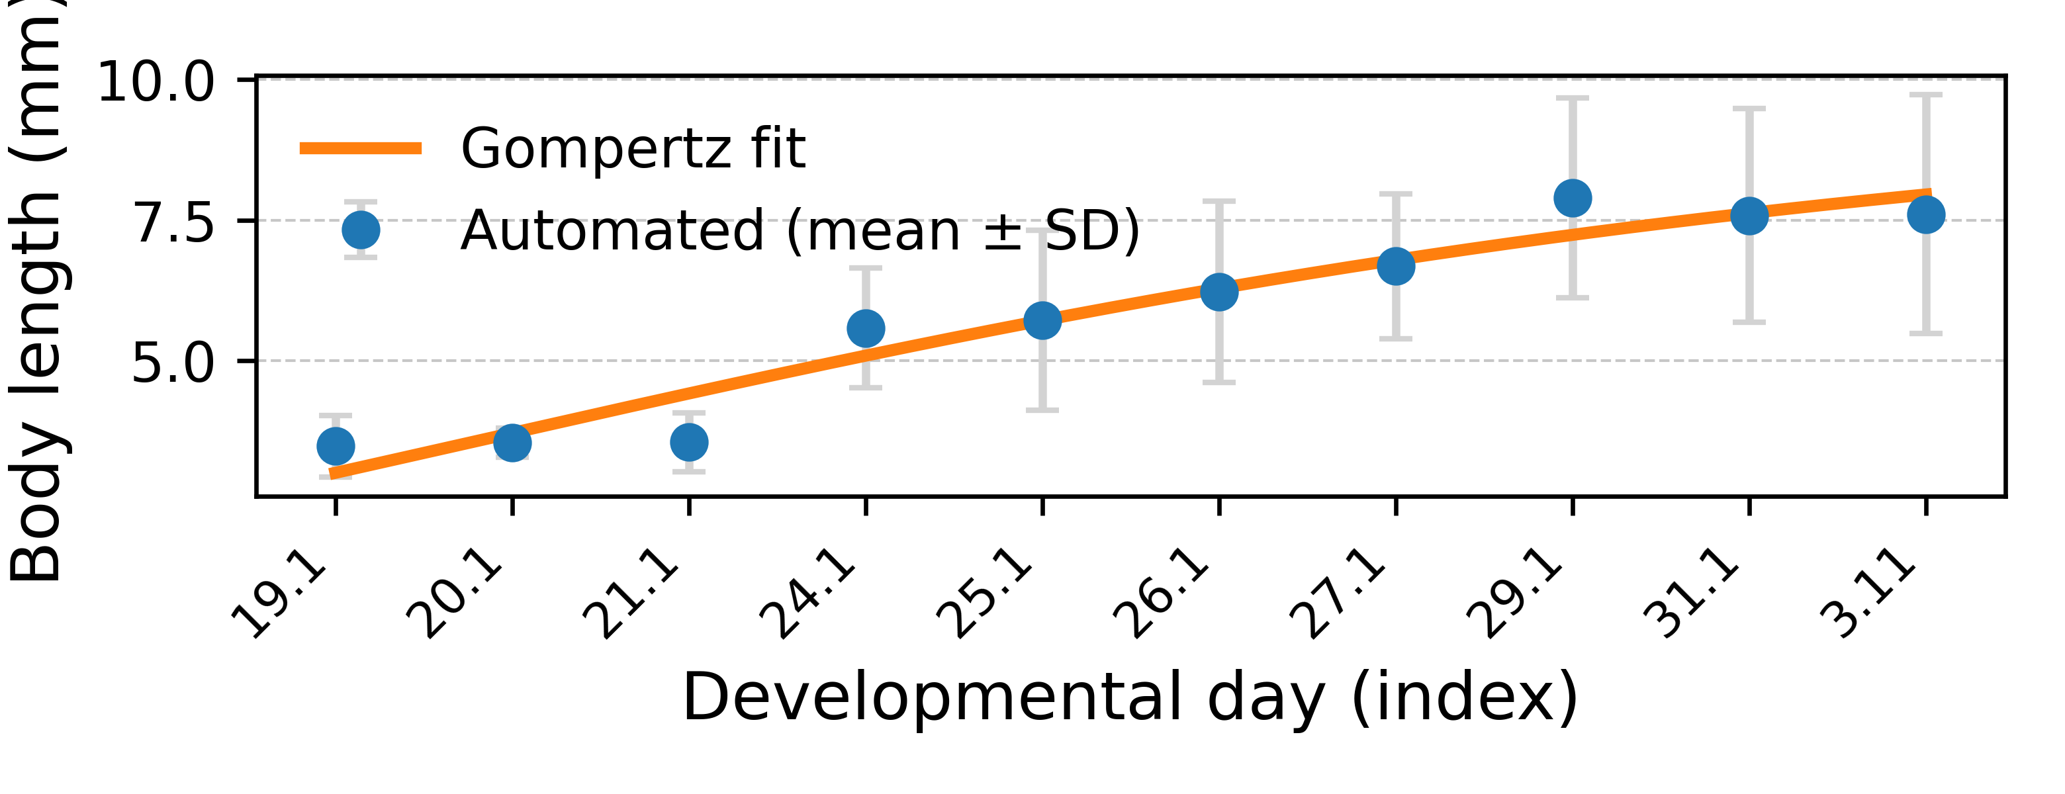


Valid
Invalid
x
✓
Raw Image
Larvae Segmentation
Larvae Detection
Posture Filtering
Population-Level Growth Estimation
Automated Length Extraction

